Slide 1
Behaviour for learning
Ice breaker style activities exploring our basic behaviour standards for the DREAMS Lab including:
Explain the standard routines you wish to set for your classes e.g. lining up, finding their assigned seats, how to store ipad in the room, how to sit at the desks
Using the classroom screen/ digital displays for classroom organization
How we ask questions, how we communicate with adults and peers
How we exit the room
What do if no adult is present
What to do if the adult is working with another student (independent learning strategies)

Slide 2
Ipad related skills and knowledge
Set up Apple classroom on their personal devices
Complete the notes template for all their information such as login, laptop/ ipad numbers, co-spaces etc.
How to join Google Classroom, seesaw
How to customise the control panel
How to airdrop, screenshot, screen record
How to turn storage to device from icloud and manually delete media
How to close apps/ tabs and set them to close automatically
Find me bingo style.

Slide 3
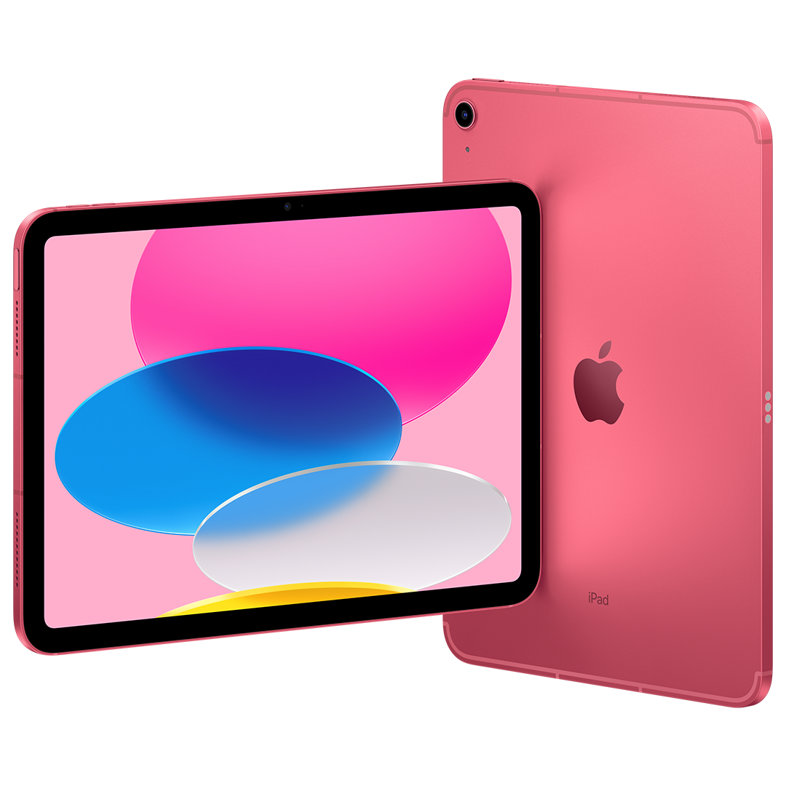
Welcome to the
DREAMS Lab!
Y3/Y4
iPads

Slide 4
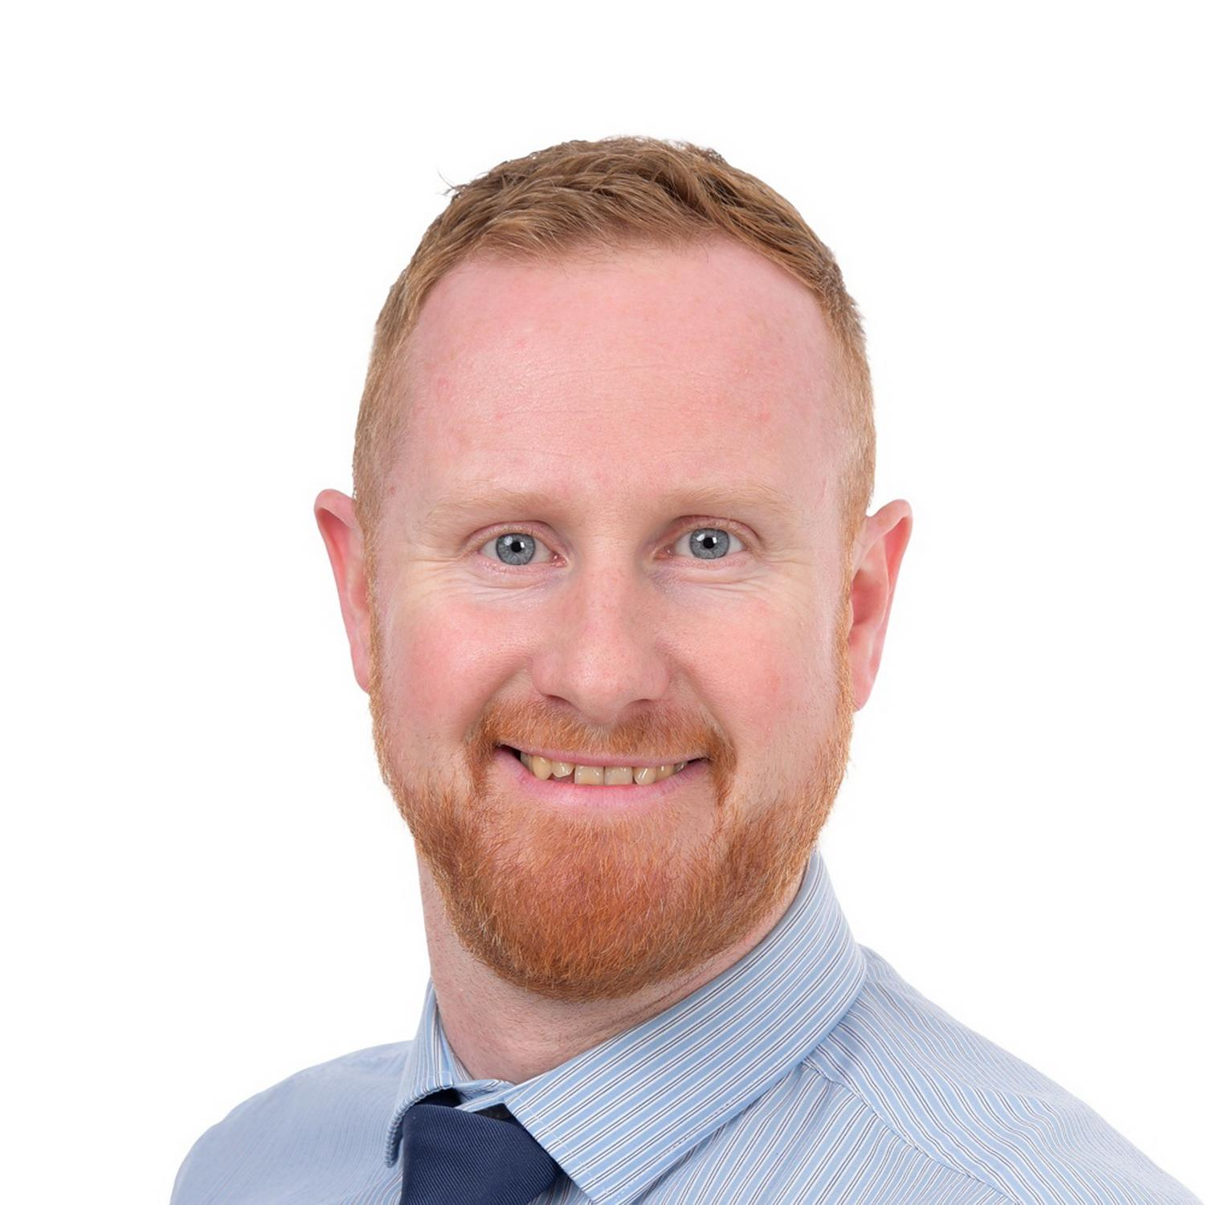
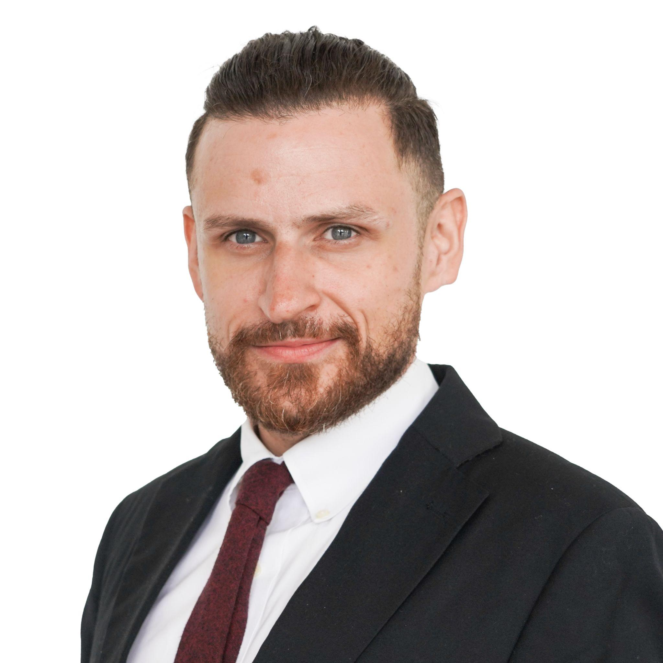
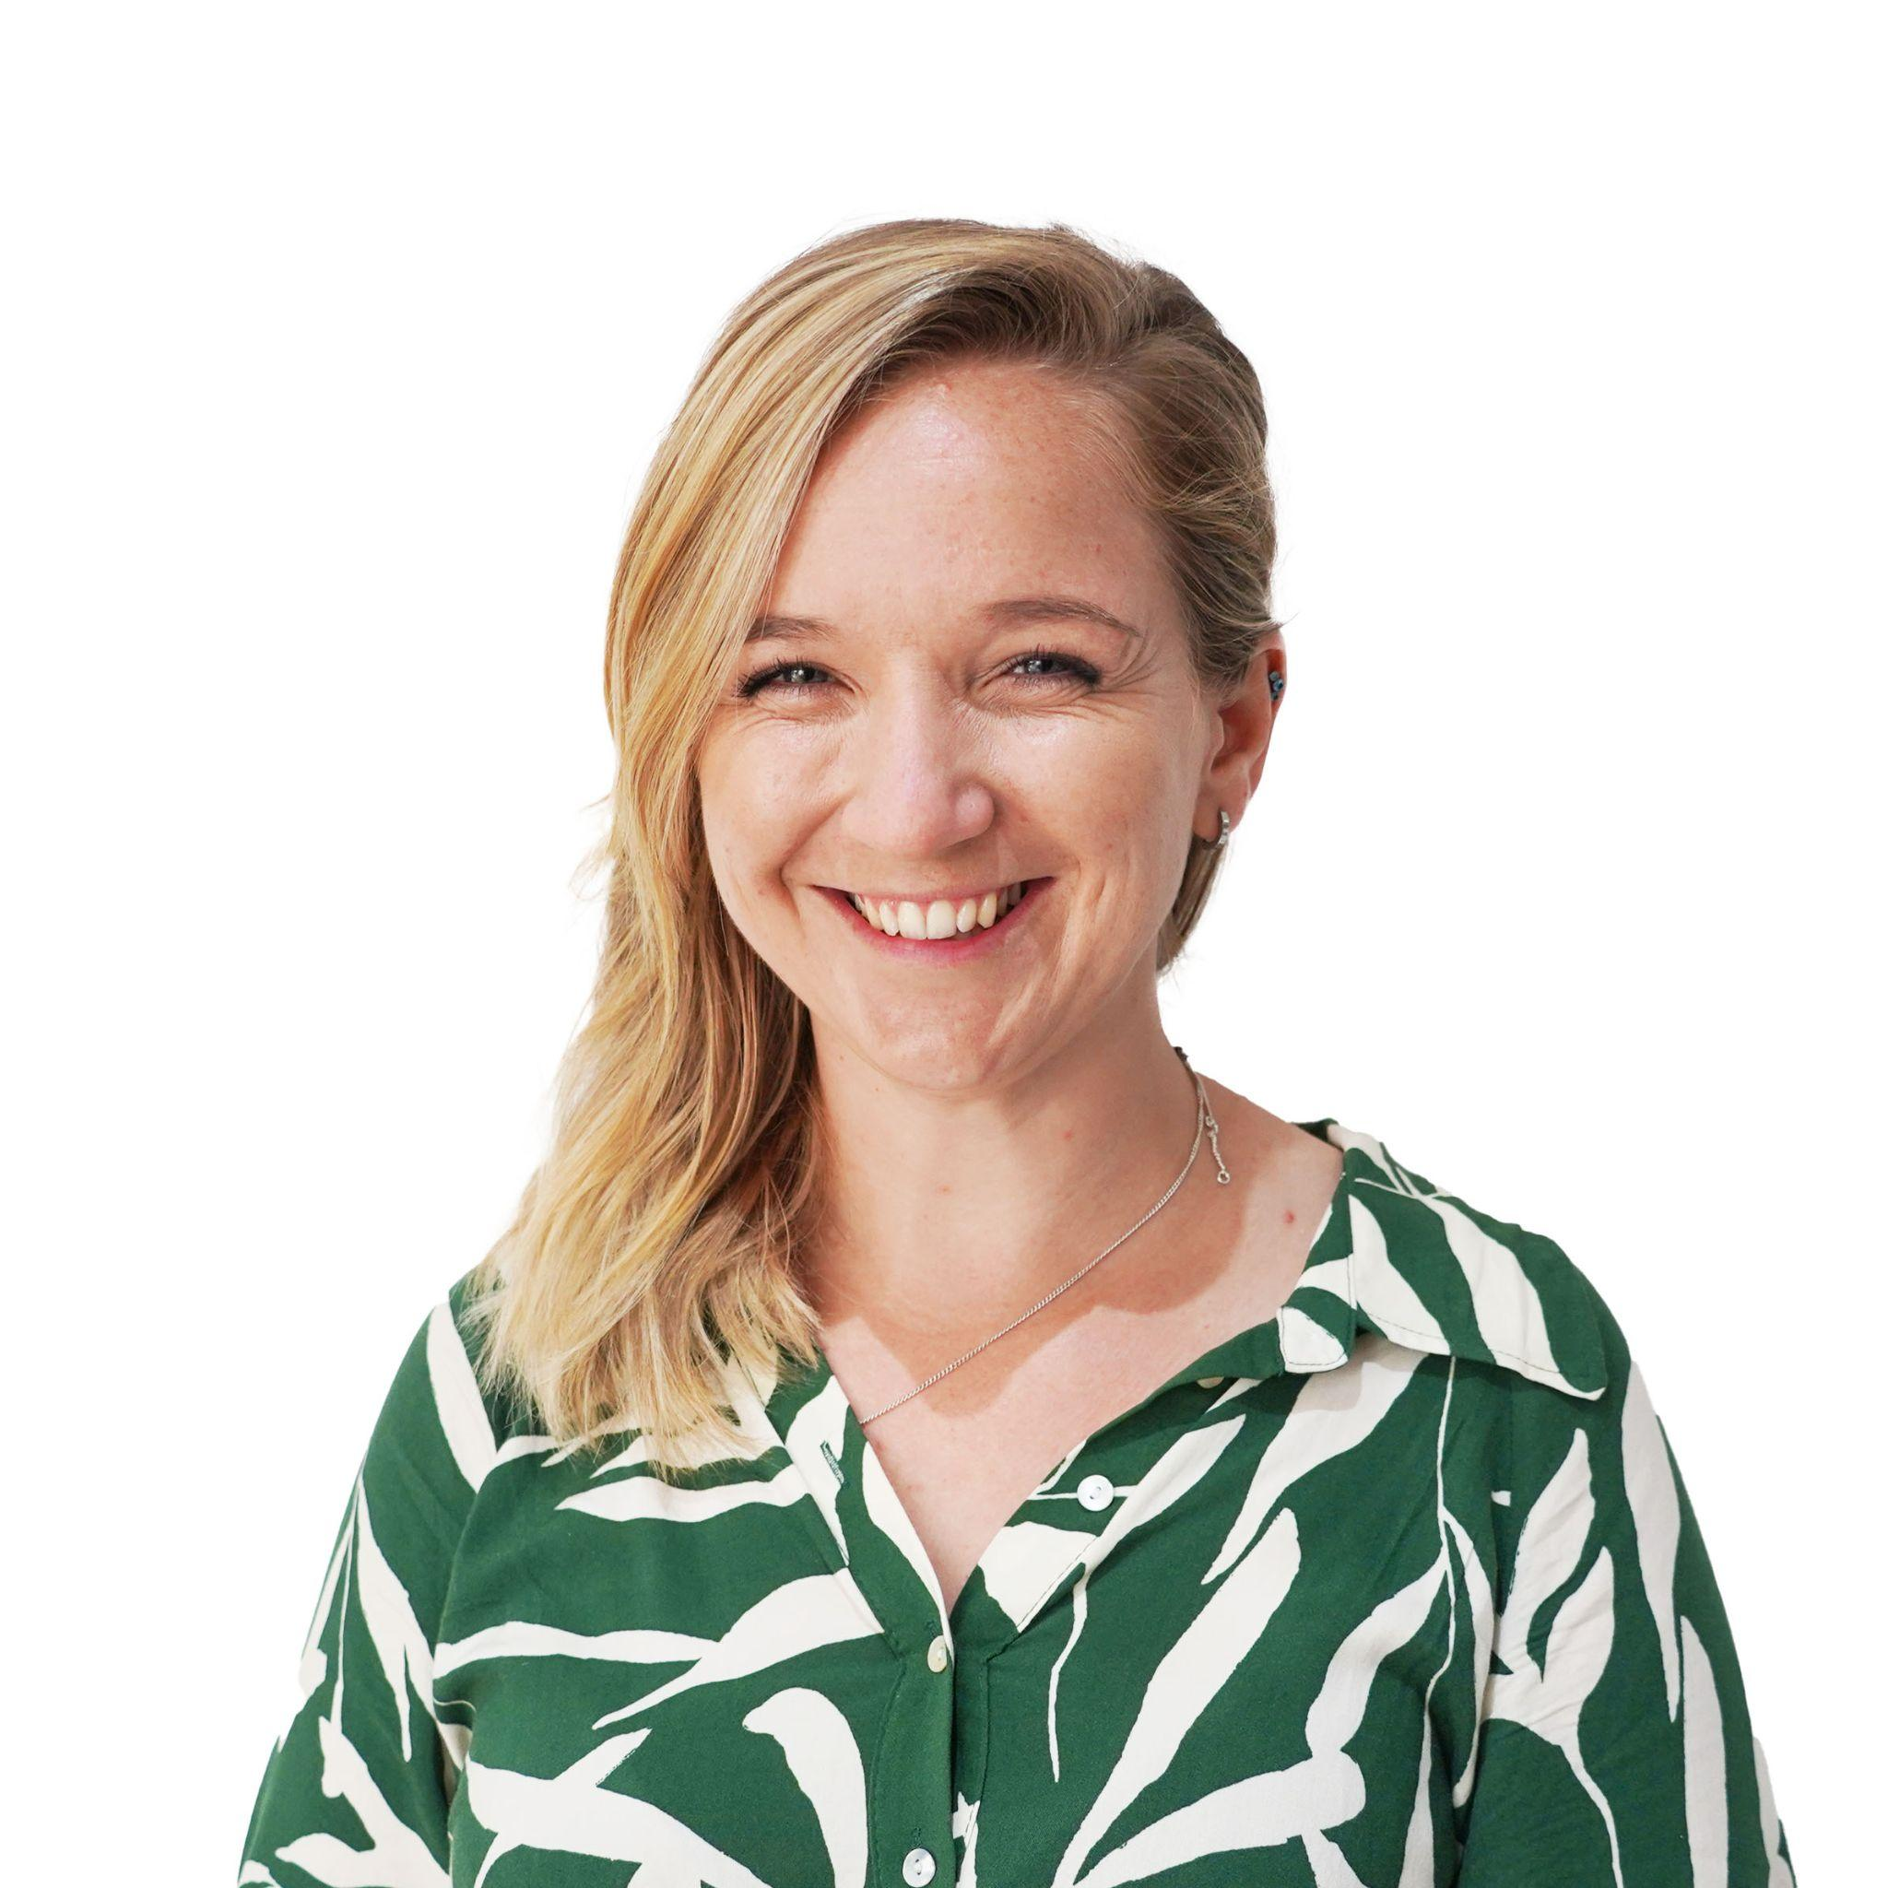
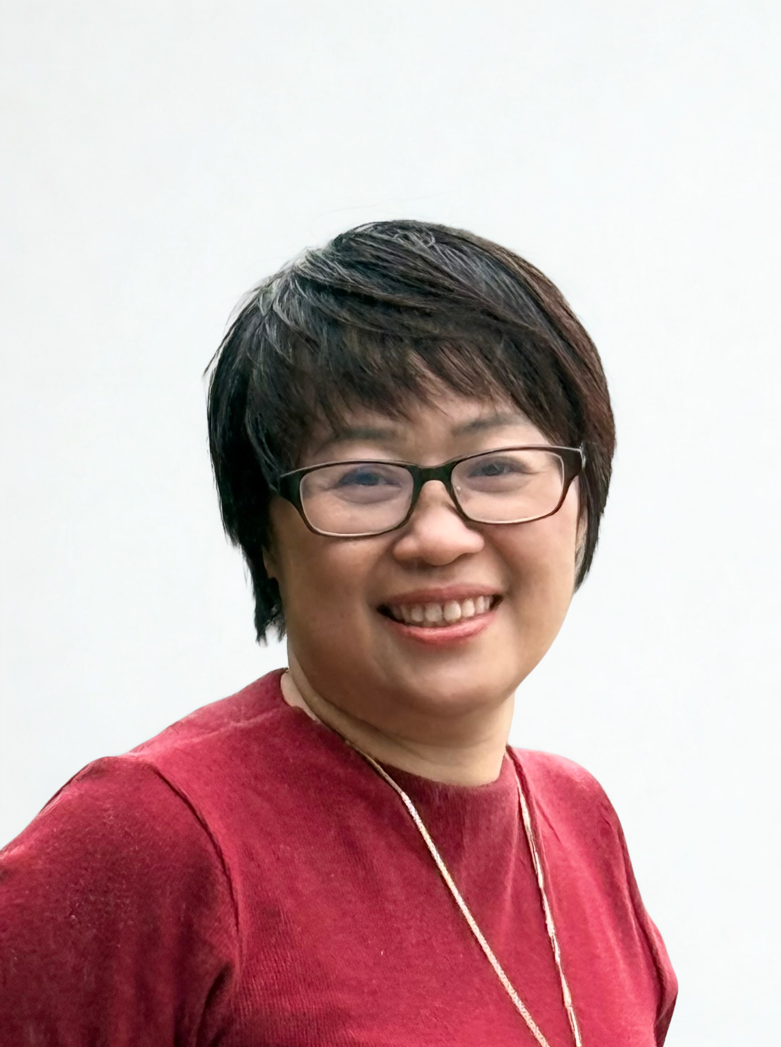
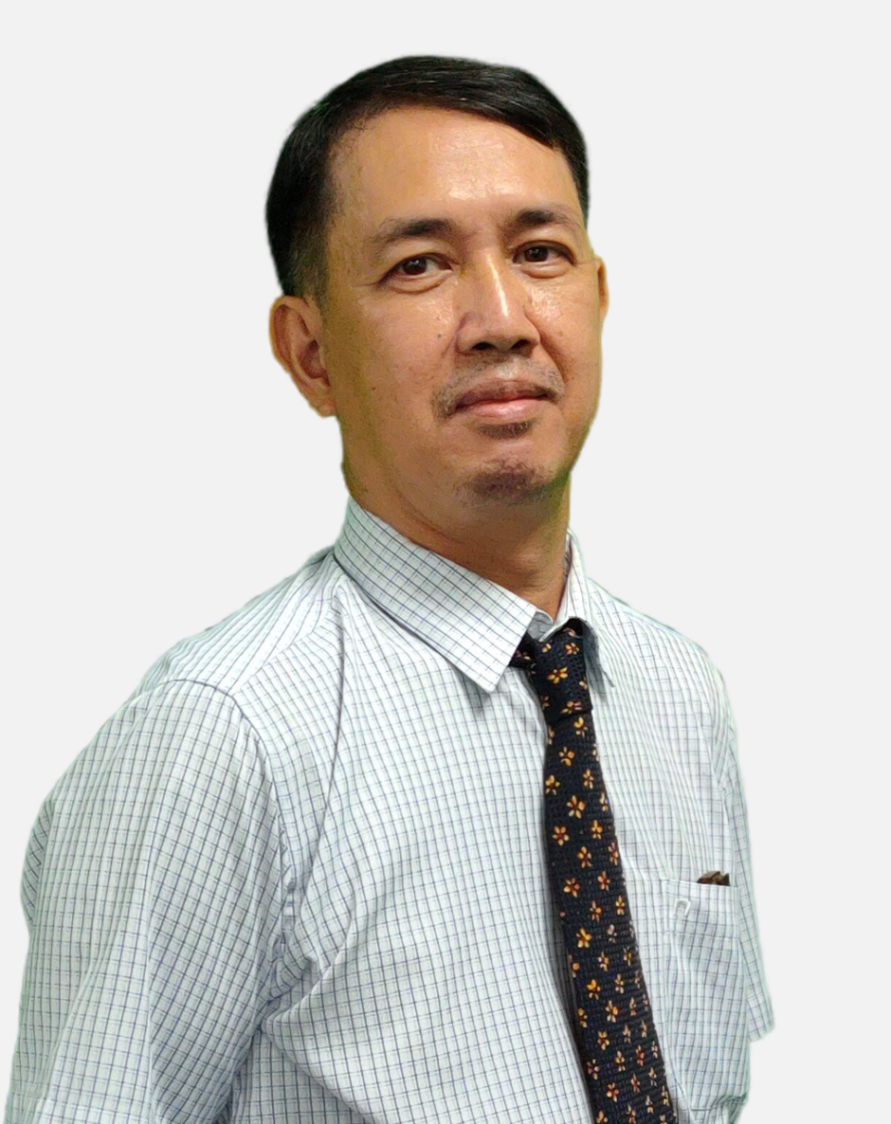
Meet the team
Mr Anthony
Head of ICT
Mr Patrick
Ms Rhian
Mr Tue
Ms Uyen

Slide 5
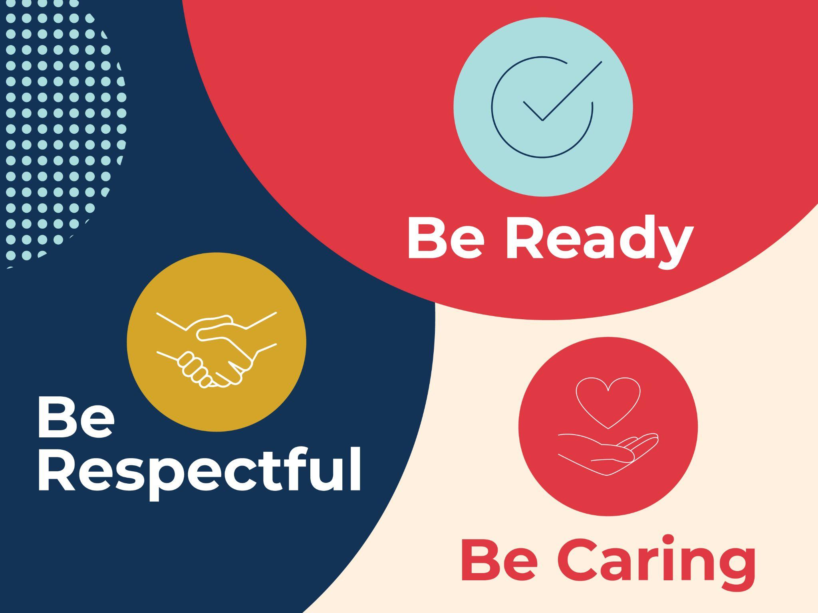
What do these look like in the DREAMS
Labs?

Slide 6
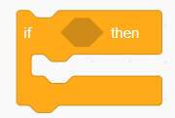
Dreams Lab Expectations

Slide 7

If…then…
…I should play on my iPad.
…I should speak loudly to my friends.
If I am waiting outside for my teacher, then….
…I should wait quietly against the wall.
…I should just go in and wait inside.
Notes:
Can stand up and go to the corner, nominate one person from each table to go to the corner or just point to the corner… depends on energy of class

Slide 8
If…then…
…. Sit and wait for someone to help me
…. I should play a random game on my iPad
If I am stuck and I don’t know what to do next, then….
….. Go and ask my Class teacher
…. C3 B4 Me
(ask 3 friends for help before asking your ICT Teacher)

Slide 9
If…then…
…. I will put my headphones in and stay quiet
…. I will stay quiet and let everyone else do the work
If I am asked to work with a partner or in a group, then….
…. I will listen to everyone and make sure everyone is involved
…. I will do all the work myself

Slide 10
If…then…
… my ICT teacher will give me 2 warnings before I need to sit out of the learning.
…. My parents will be asked to come in to school
If I am not showing respect, care and showing I am ready, then….
….. I can sing
…. I don’t need to listen in ICT, it’s ok

Slide 11

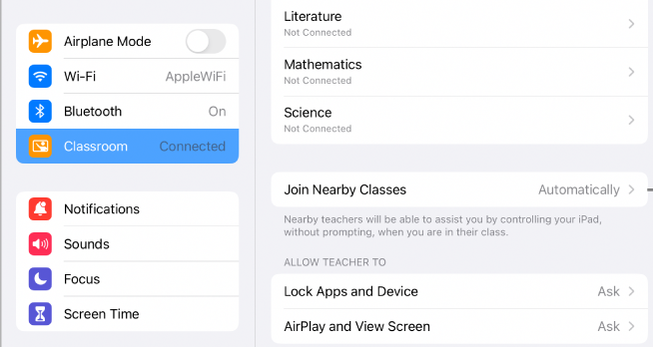
Setting up Apple Classroom
Turn WIFI on and connect to ‘EDUCATION’ network
Go to settings and look for the logo
Tap blue words Add/ join class e.g ‘3B ICT Mr Anthony’
Notes:
Student’s may not know their passwords yet. Provide them with the excel doc when provided by Maria

Slide 12
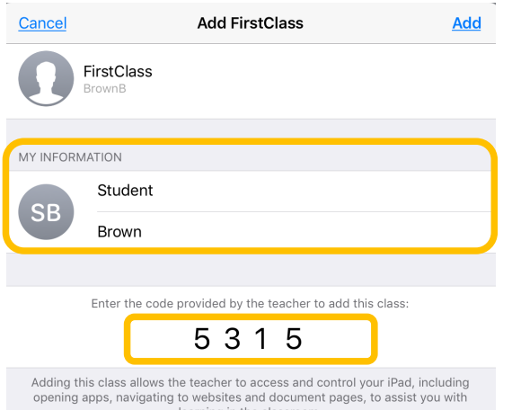
Setting up Apple Classroom
Enter the code you see on the screen
Write your first and last name
Tap add
ALLOW ALL permissions
Wait for teacher
X X X X
Notes:
Student’s may not know their passwords yet. Provide them with the excel doc when provided by Maria

Slide 13

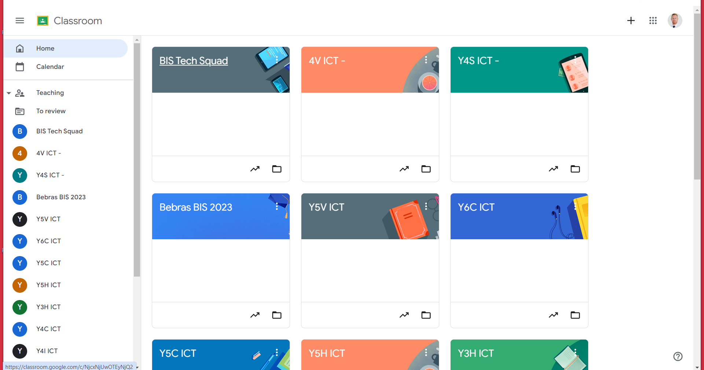
Join Google Classroom
Join Class

Slide 14
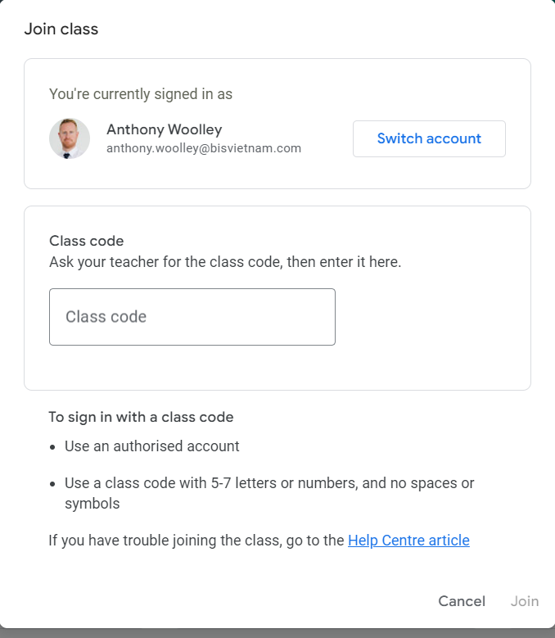
Enter class code

Slide 15
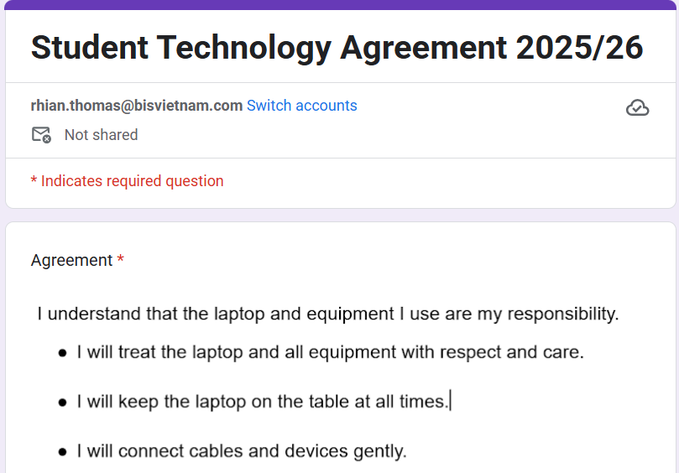
Agree and sign on Google Forms

Slide 16
Notes template

Slide 17
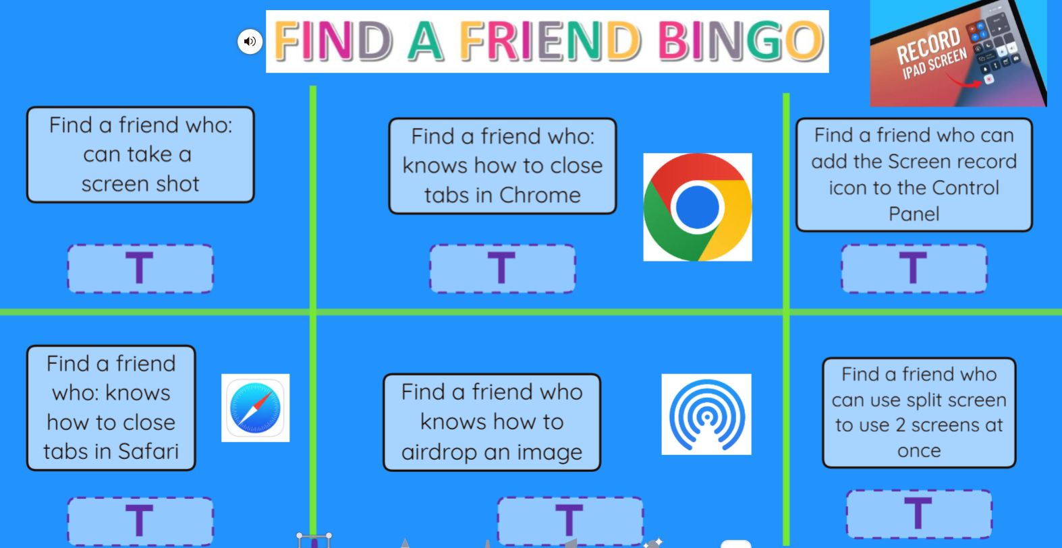
Notes:
Seesaw link

Slide 18
Laptop related skills and knowledge
How to collect and return the laptops
Navigating the keyboard and special characters
How to log into the devices
How to sign into Chrome account
How to access the Google Apps for Learning
Bookmark google Classroom
Joining Google Classroom
Correct shutdown process
Completing the laptop agreement (laptop or ipad)
Notes:
Y3-4 Sites to pin to Google Classroom. TinkerCAd, Seesaw, Code.org, Make Code Arcade, Make Code microbit, Canva, Google Classroom, co-Spaces local editor,

Slide 19
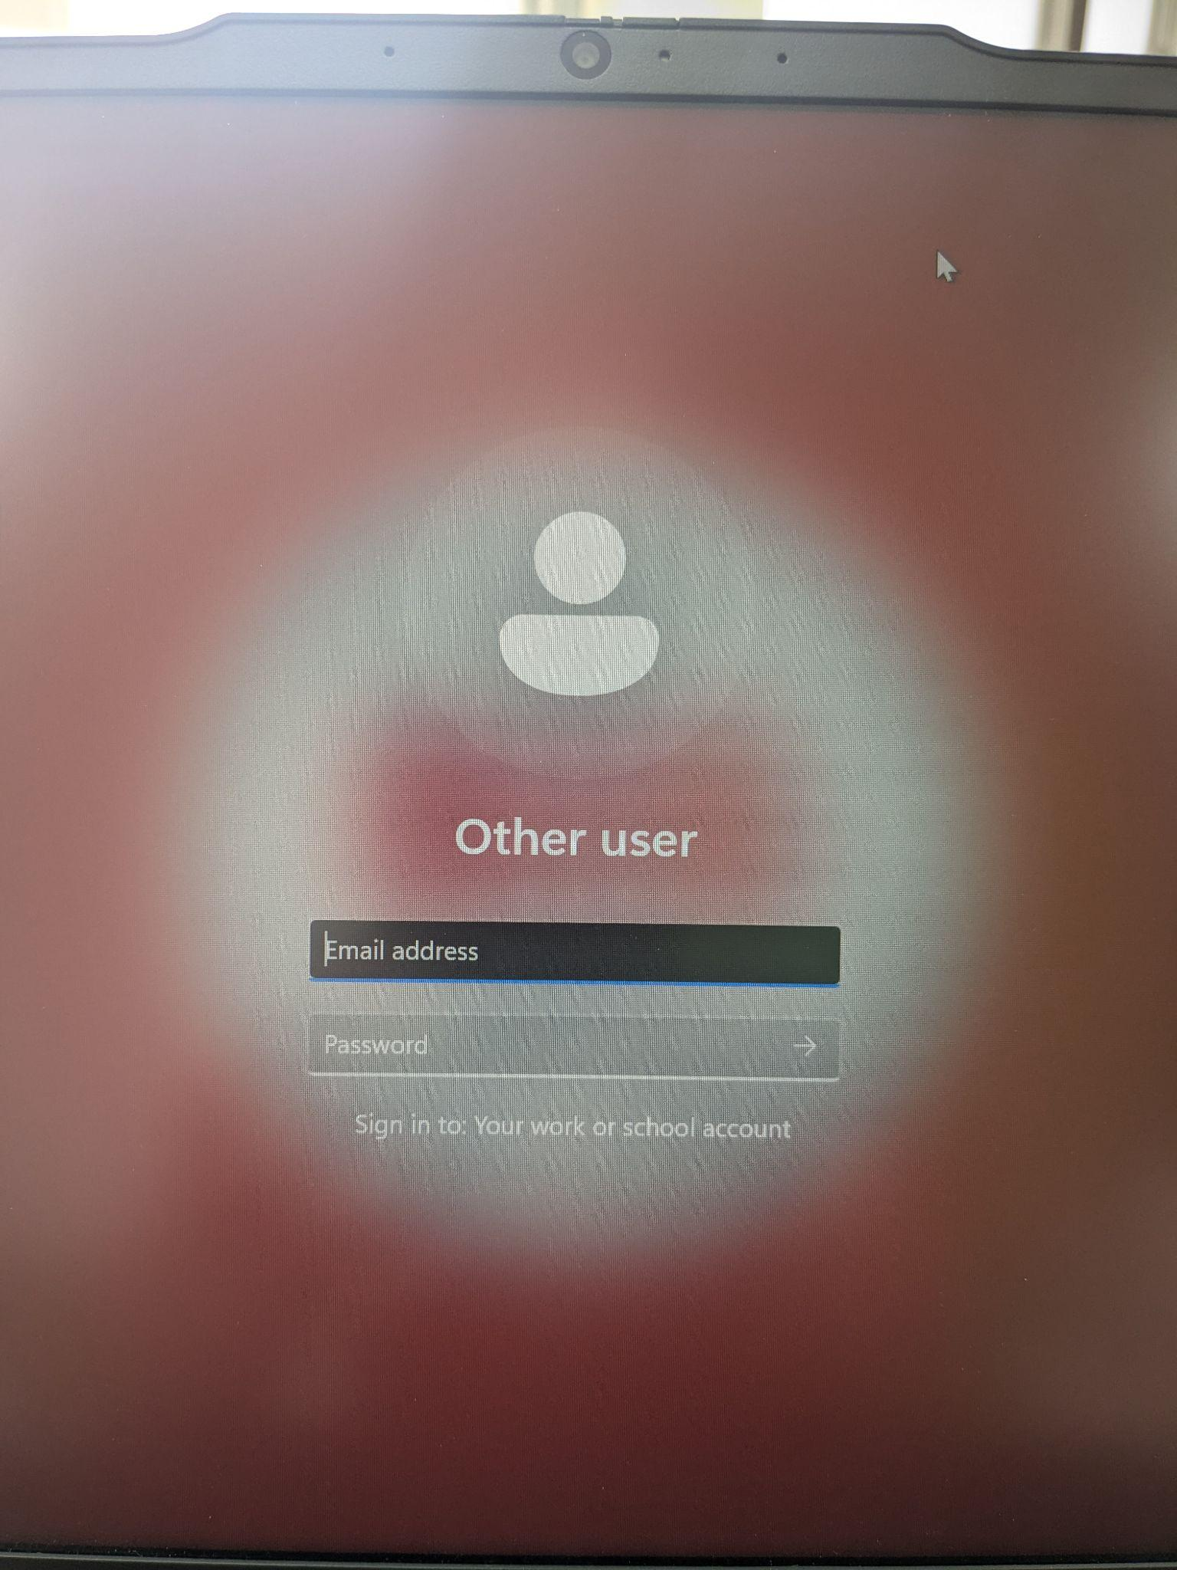
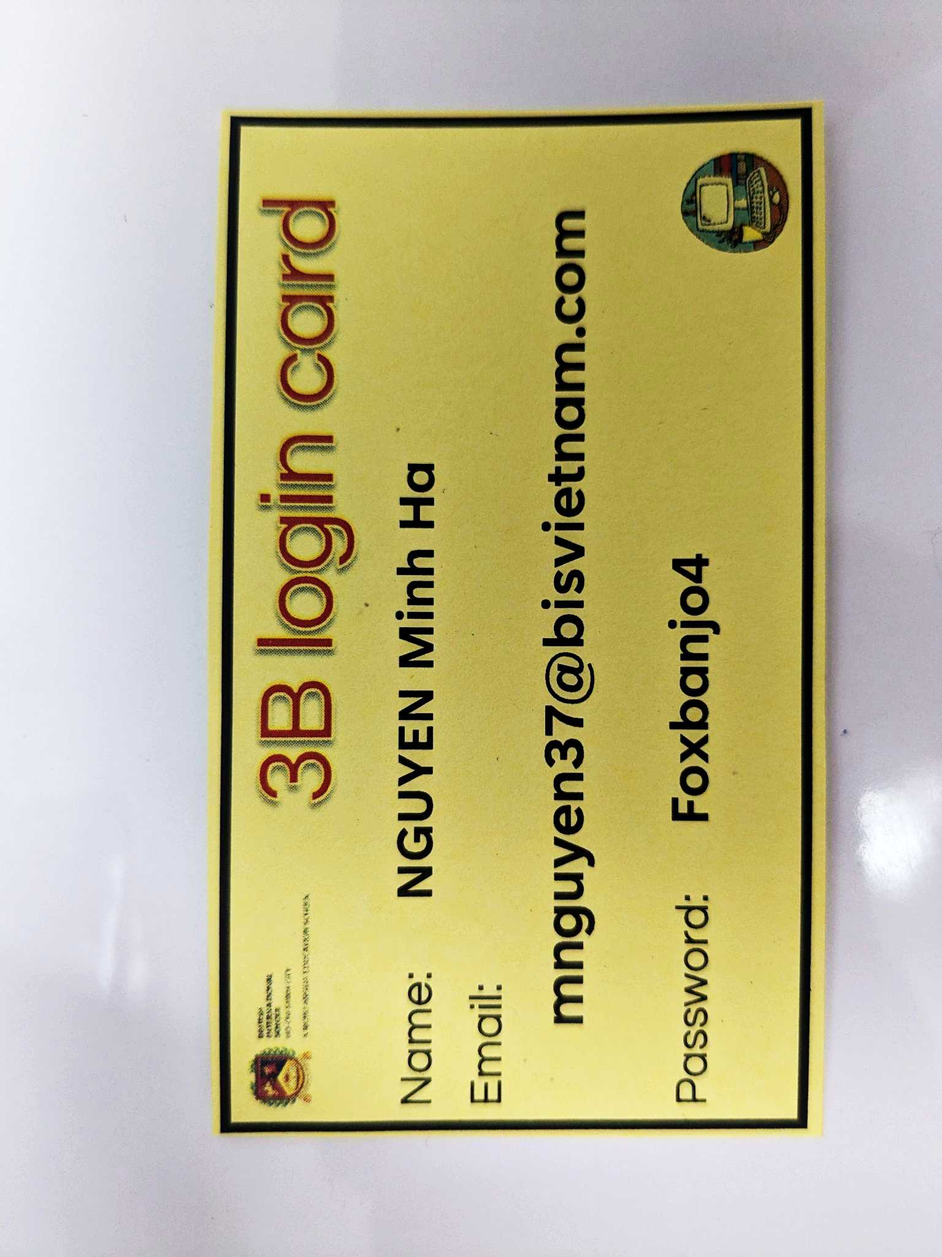
Logging in:
Login

Slide 20
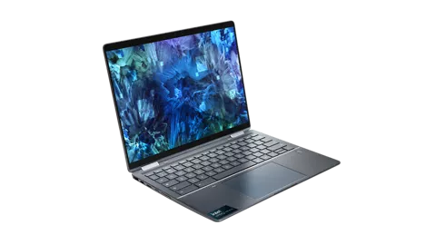
Welcome to the
DREAMS Lab Y3/Y4
Laptops

Slide 21
Meet the team
Mr Anthony
Head of ICT
Mr Patrick
Ms Rhian
Mr Tue
Ms Uyen

Slide 22
What do these look like in the DREAMS
Labs?

Slide 23
Dreams Lab Expectations

Slide 24
If…then…
…I should play on my iPad.
…I should speak loudly to my friends.
If I am waiting outside for my teacher, then….
…I should wait quietly against the wall.
…I should just go in and wait inside.
Notes:
Can stand up and go to the corner, nominate one person from each table to go to the corner or just point to the corner… depends on energy of class

Slide 25
If…then…
…. Sit and wait for someone to help me
…. I should play a random game on my iPad
If I am stuck and I don’t know what to do next, then….
….. Go and ask my Class teacher
…. C3 B4 Me
(ask 3 friends for help before asking your ICT Teacher)

Slide 26
If…then…
…. I will put my headphones in and stay quiet
…. I will stay quiet and let everyone else do the work
If I am asked to work with a partner or in a group, then….
…. I will listen to everyone and make sure everyone is involved
…. I will do all the work myself

Slide 27
If…then…
… my ICT teacher will give me 2 warnings before I need to sit out of the learning.
…. My parents will be asked to come in to school
If I am not showing respect, care and showing I am ready, then….
….. I can sing
…. I don’t need to listen in ICT, it’s ok

Slide 28
3 Things going to happen

Slide 29

Open the lid, don’t turn it on yet!
Notes:
Display Laptop number on Classroom screen

Slide 30

Let’s take a tour:
Can you point to:
On/Off button
Charging port
Trackpad
Trackpoint- pointing stick
Headphones port

Slide 31
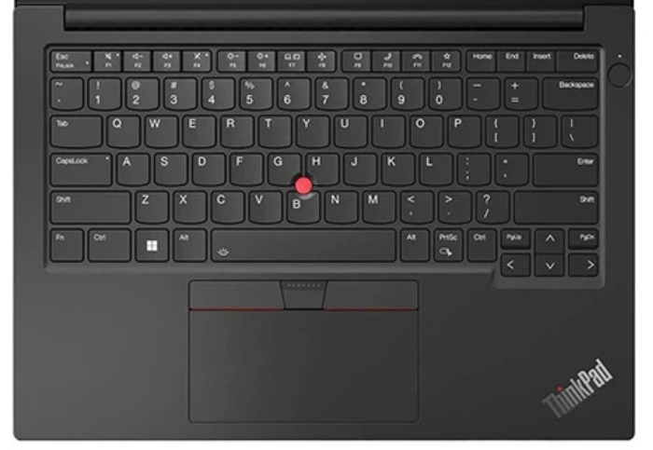

2. Press @
1.Press and hold on Shift

Slide 32
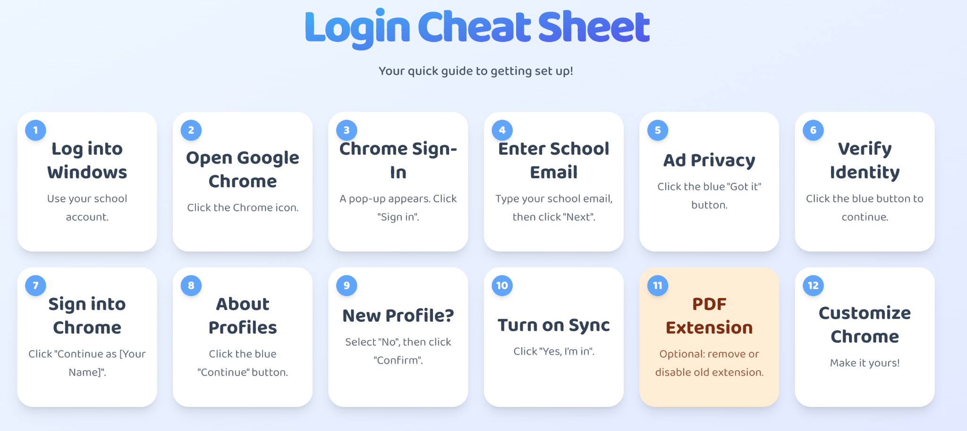
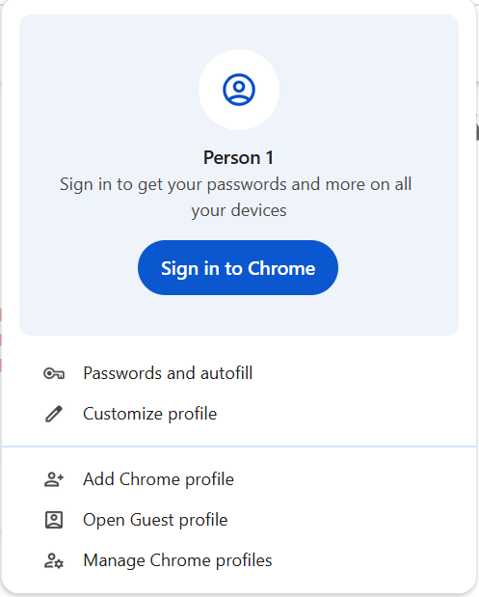



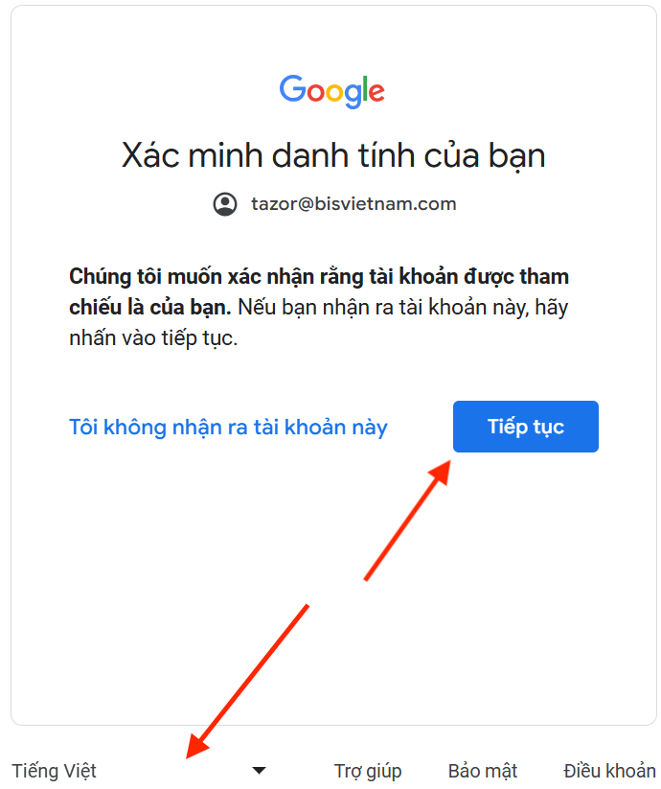

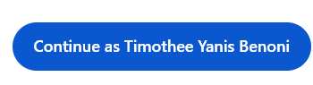
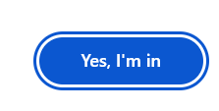
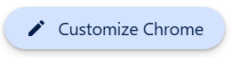
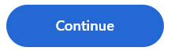
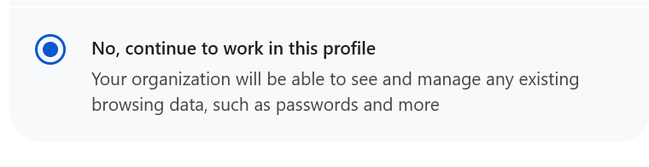
Your name

Slide 33
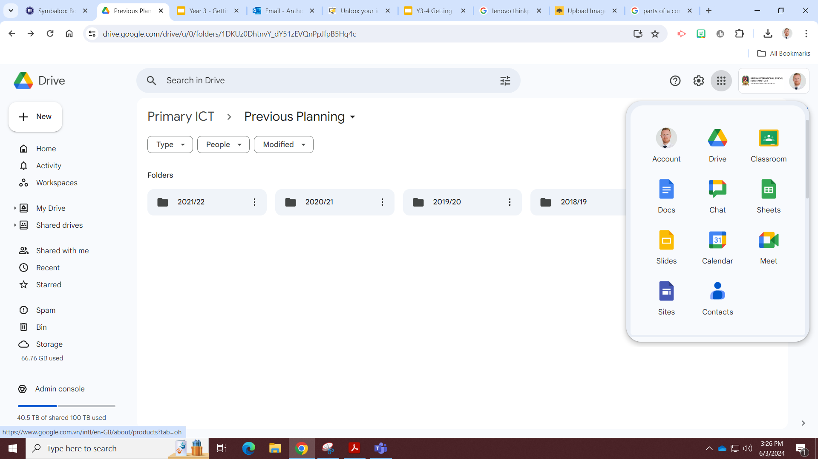
The Waffle

Slide 34
Join Google Classroom
Join Class

Slide 35
Enter class code

Slide 36
Agree and sign on Google Forms

Slide 37

Do you know how to Bookmark Google Classroom?
Notes:
Chalk and Talk

Slide 38
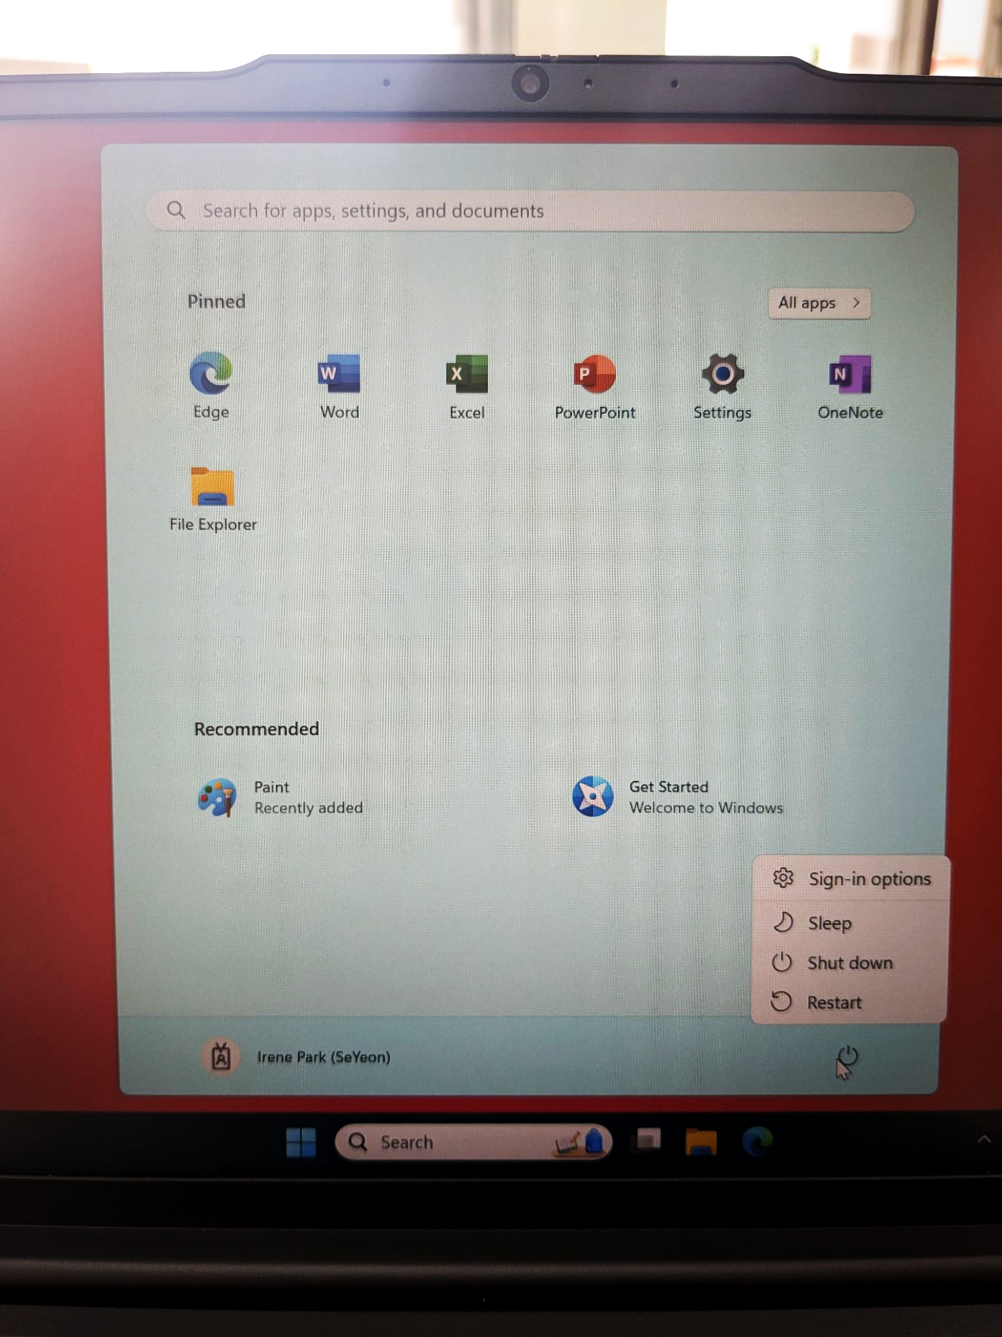
Shut down your laptop:
After every lesson please shut the laptop down so it is ready for the next person!

Slide 39
Your name

Slide 40
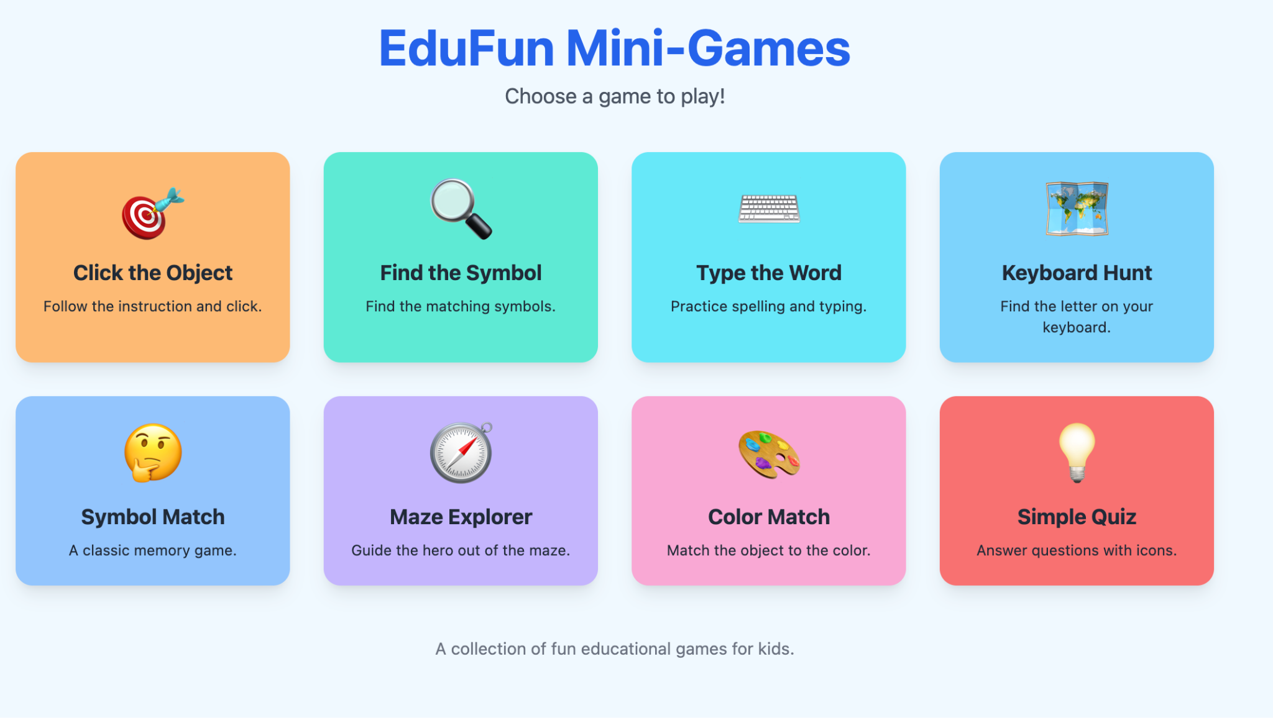
Notes:
Extension tasks
https://digital-playground-fun-tech-games-y3-4-801886913830.us-west1.run.app/
Alternative
https://edufun-mini-games-y3-4-801886913830.us-west1.run.app/#/

Slide 41
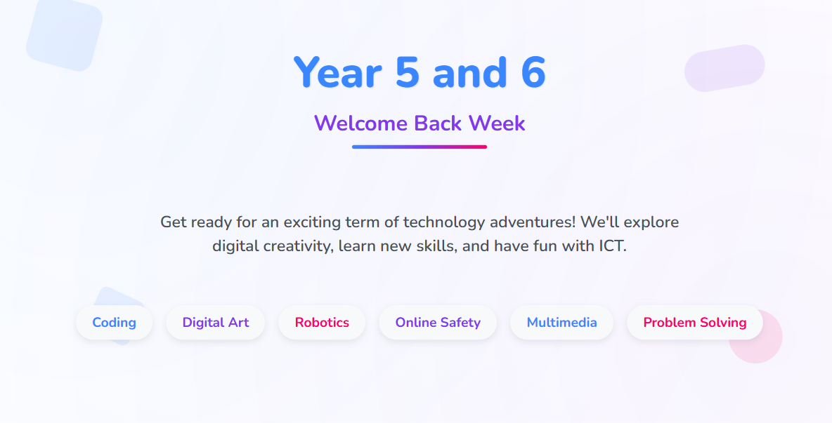

Slide 42
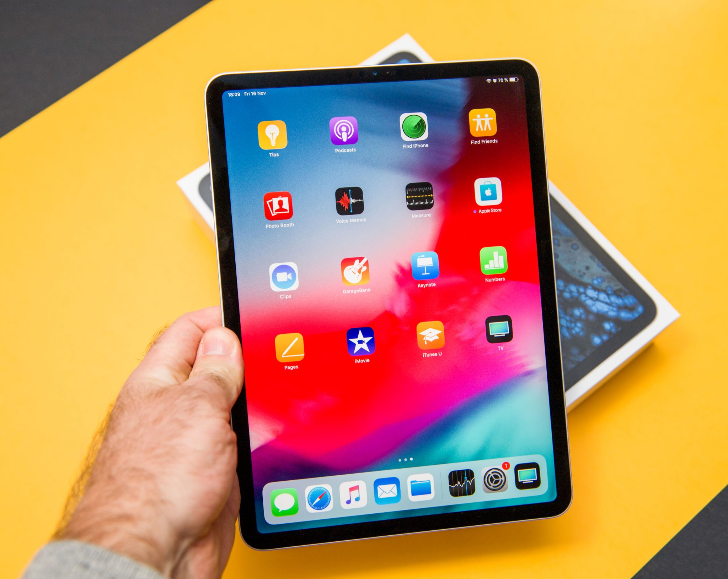
Notes:
Lesson flow:
Find seats via classroom screen
Connect devices to the wifi using the new passwords
Connect to Apple Classroom
Connect to Google Classroom
Complete Agreement form https://forms.gle/4EpEd23tDfAA4NqBA
Routines, behaviours and expectations
Wayground Quiz https://wayground.com/admin/quiz/68999e2e17eb2c98b5dd68fb
iPad skills builder activity

Slide 43
Setting up Apple Classroom
Turn WIFI on and connect to ‘EDUCATION’ network
Go to settings and look for the logo
Tap blue words Add/ join class e.g ‘3B ICT Mr Anthony’
Notes:
Student’s may not know their passwords yet. Provide them with the excel doc when provided by Maria

Slide 44
Setting up Apple Classroom
Enter the code you see on the screen
Write your first and last name
Tap add
ALLOW ALL permissions
Wait for teacher
X X X X
Notes:
Student’s may not know their passwords yet. Provide them with the excel doc when provided by Maria

Slide 45
Join Google Classroom
Join Class

Slide 46
Enter class code

Slide 47
Agree and sign on Google Forms
Notes:
If students do not have Google Classroom App installed then sign in via safari OR airdrop the link to the agreement to their device: https://forms.gle/4EpEd23tDfAA4NqBA

Slide 48

What do you already know?
Scan the QR code and take the iPad basic skills quiz and test your knowledge. If you score below 50% retake the quiz and try and beat your score!
Notes:
https://wayground.com/admin/quiz/68999e2e17eb2c98b5dd68fb
Quiziz is now called wayground!!!! Link is above, host and generate QR code

Slide 49
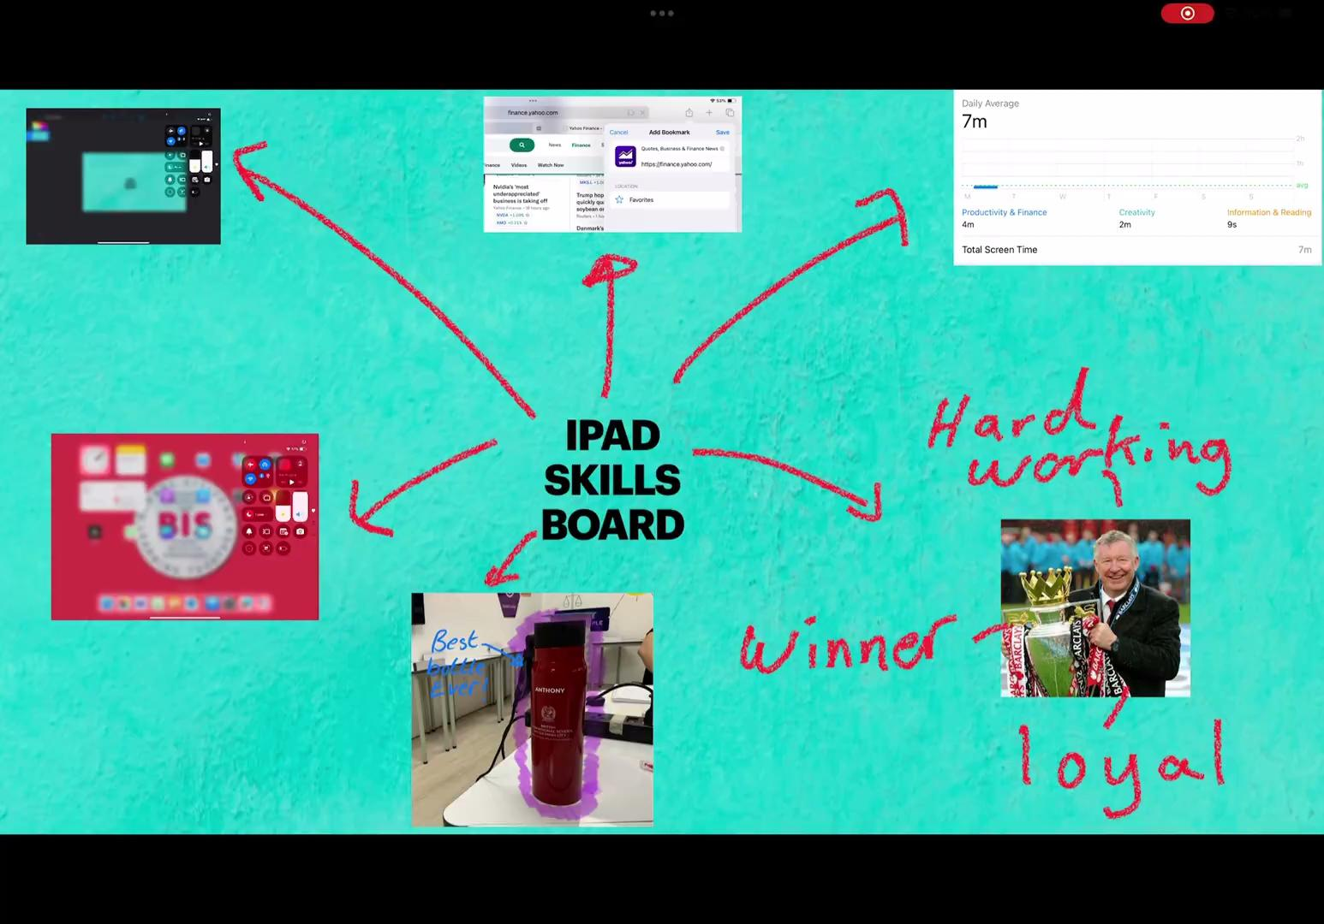



iPad skills builder
Complete the skills from the choice and present them in an app of your choice. E.g. Freeform, Keynote, Canva, slides etc.
Look at the example!

Slide 50
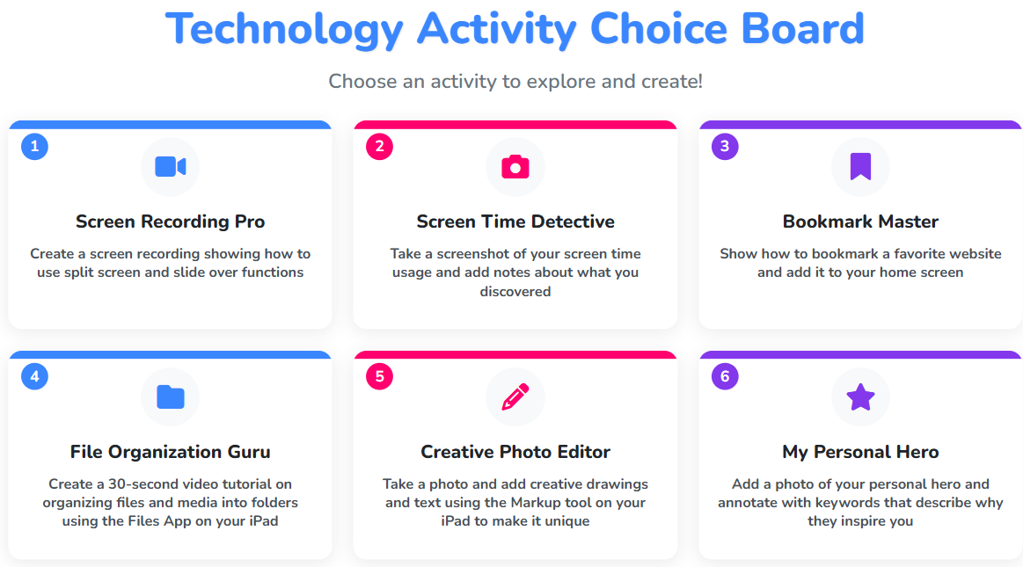

Slide 51
Welcome to the
DREAMS Lab
Y5/6
Laptops
Notes:
Lesson flow:
Find seats via classroom screen
Login into Computer -> Google Chrome
Connect to Google Classroom
Complete Agreement form https://forms.gle/4EpEd23tDfAA4NqBA
Routines, behaviours and expectations
Digital Skills Academy

Slide 52
Your name
Notes:
Lesson flow:
Find seats via classroom screen
Login into Computer -> Google Chrome
Connect to Google Classroom
Complete Agreement form https://forms.gle/4EpEd23tDfAA4NqBA
Routines, behaviours and expectations
Digital Skills Academy

Slide 53
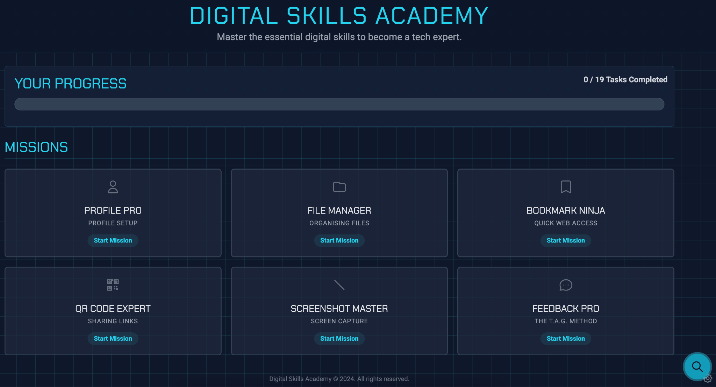
Notes:
https://digital-skills-academy-y5-6-801886913830.us-west1.run.app/
Lesson flow:
Find seats via classroom screen
Login into Computer -> Google Chrome
Connect to Google Classroom
Complete Agreement form https://forms.gle/4EpEd23tDfAA4NqBA
Routines, behaviours and expectations
Digital Skills Academy

